Slide 1
Week 13c
COMPUTATIONAL MATHEMATICS
2D Optimization Method – Gradient Method
Wednesday, 10 June 2020

Slide 2
Reference
Kisualaas, Jann. (2013). Numerical Methods in Engineering with Python 3. Cambridge University Press.
Johansson, Robert. (2015). Chapter 5. Equation Solving. Numerical Python: A Practical Techniques Approach for Industry, Apress.
Chapra, S. C., and Raymond P. Canale. (2010). Numerical methods for engineers, Sixth edition, McGraw Hill.
Kaw, A. (n.d.). Numerical Methods. Retrieved March 20, 2020, from https://nm.mathforcollege.com/

Slide 3
Optimization Methods
One-Dimensional Unconstrained Optimization
Golden-Section Search
Quadratic Interpolation
Newton's Method
Multi-Dimensional Unconstrained Optimization
Non-gradient or direct methods
Gradient methods
Linear Programming (Constrained)
Graphical Solution
Simplex Method

Slide 4
Gradient
The gradient vector of a function f, denoted as f, tells us that from an arbitrary point
Which direction is the steepest ascend/descend?
i.e. Direction that will yield the greatest change in f
How much we will gain by taking that step?
Indicate by the magnitude of f = || f ||₂

Slide 5
Gradient – Example
Problem: Employ gradient to evaluate the steepest ascent direction for the function f(x, y) = xy² at point (2, 2).
Solution:
8 unit
θ
4 unit

Slide 6
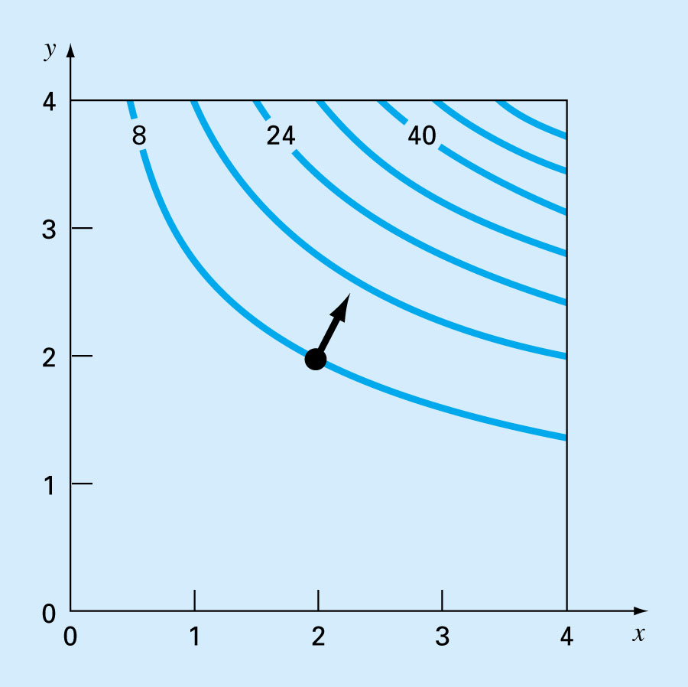
The direction of steepest ascent (gradient) is generally perpendicular, or orthogonal, to the elevation contour.

Slide 7
Detecting Optimum Point
For 1-D problems
If f'(x') = 0
and
If f"(x') < 0, then x' is a maximum point
If f"(x') > 0, then x' is a maximum point
If f"(x') = 0, then x' is a saddle point
What about for multi-dimensional problems?

Slide 8
Detecting Optimum Point
For 2-D problems, if a point is an optimum point, then
In addition, if the point is a maximum point, then
Question: If both of these conditions are satisfied for a point, can we conclude that the point is a maximum point?

Slide 9
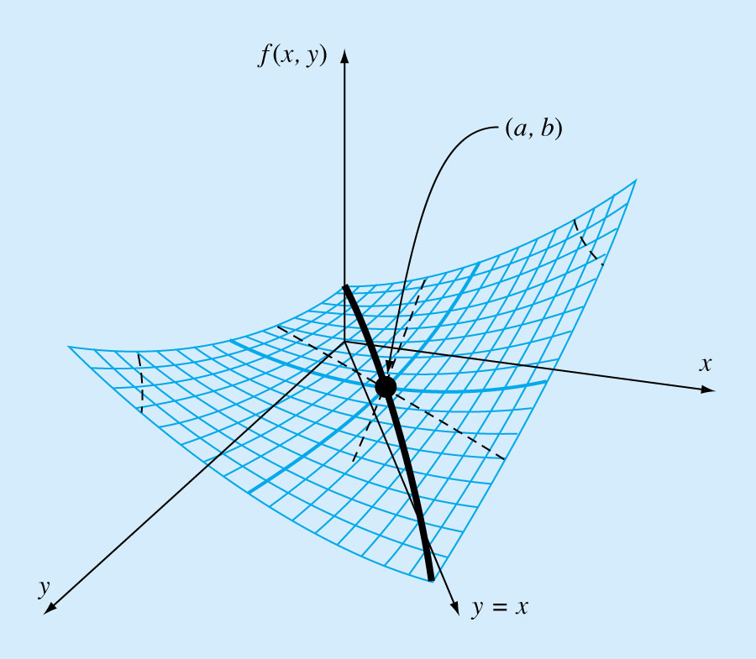
Detecting Optimum Point
When viewed along the x and y directions.
When viewed along the y = x direction.
(a, b) is a saddle point

Slide 10
Detecting Optimum Point
For 2-D functions, we also have to take into consideration of
That is, whether a maximum or a minimum occurs involves both partial derivatives w.r.t. x and y and the second partials w.r.t. x and y.

Slide 11
Hessian Matrix (or Hessian of f )
n=2
Also known as the matrix of second partial derivatives.
Its determinant, |H|, provides a way to discern if a function has reached an optimum or not.

Slide 12
Detecting Optimum Point
Assuming that the partial derivatives are continuous at and near the point being evaluated
The quantity |H| is equal to the determinant of the Hessian matrix of f.

Slide 13
Finite Difference Approximation using
Centered-difference approach
Used when evaluating partial derivatives is inconvenient.

Slide 14
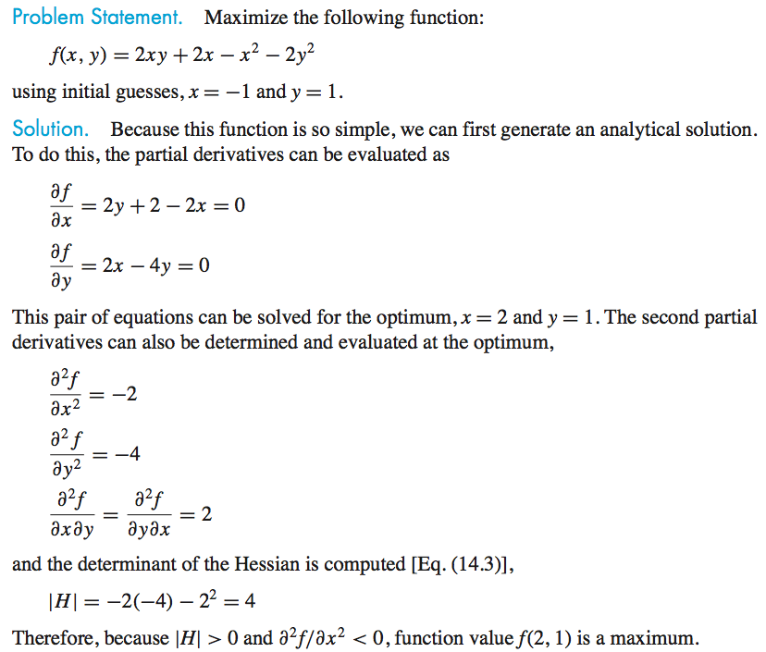
Example

Slide 15
Steepest Ascent Method
Start at x₁ = { x₁, x₂, …, x_{n} }
i = 0
Repeat
i = i + 1
S_{i} = f at x_{i}
Find h such that f (x_{i} + hS_{i}) is maximized
x_{i+1} = x_{i} + hS_{i}
Until (|(f(x_{i+1}) – f(x_{i})) / f(x_{i+1})| < e_{s1} or
|| x_{i+1} – x_{i}||/||x_{i+1}|| < e_{s2})
Steepest ascent method converges linearly.

Slide 16
Steepest Ascent Method – Maximizing f (x_{i} + hS_{i})
Let g(h) = f (x_{i} + hS_{i})
g(h) is a parameterized version of f (x_{i}) and has only one variable.
If g(h') is optimal, then f (x_{i} + h'S_{i}) is also optimal
Thus to find h that maximizes f (x_{i} + hS_{i}), we can find the the h that maximizes g(h) using any method for optimizing 1-D function (Bisection, Newton-method, etc.)

Slide 17
Example: Suppose f(x, y) = 2xy + 2x – x² – 2y²
Using the steepest ascent method to find the next point if we are moving from point (-1, 1).
Next step is to find h that maximize g(h)

Slide 18
If h = 0.2 maximizes g(h), then x = -1+6(0.2) = 0.2 and y = 1-6(0.2) = -0.2 would maximize f(x, y).
So moving along the direction of gradient from point (-1, 1), we would reach the optimum point (which is our next point) at (0.2, -0.2).

Slide 19
Conjugate Gradient Approaches (Fletcher-Reeves)
Methods moving in conjugate directions converge quadratically.
Idea: Calculate conjugate direction at each points based on the gradient as
Converge faster than Powell's method.
Ref: Engineering Optimization (Theory & Practice), 3rd ed, by Singiresu S. Rao.

Slide 20
Newton's Method
 | One-dimensional Optimization | Multi-dimensional Optimization
At the optimal
Newton's Method
H_{i} is the Hessian matrix (or matrix of 2nd partial derivatives) of f evaluated at x_{i}.

Slide 21
Newton's Method
Converge quadratically
May diverge if the starting point is not close enough to the optimum point.

Slide 22
Marquardt Method
Idea
When a guessed point is far away from the optimum point, use the Steepest Ascend method.
As the guessed point is getting closer and closer to the optimum point, gradually switch to the Newton's method.

Slide 23
Marquardt Method
The Marquardt method achieves the objective by modifying the Hessian matrix H in the Newton's Method in the following way:
Initially, set α₀ a huge number.
Decrease the value of α_{i} in each iteration.
When x_{i} is close to the optimum point, makes α_{i} zero (or close to zero).

Slide 24
Marquardt Method
Whenα_{i} is large
Steepest Ascend Method: (i.e., Move in the direction of the gradient.)
Whenα_{i} is close to zero
Newton's Method

